Slide 1
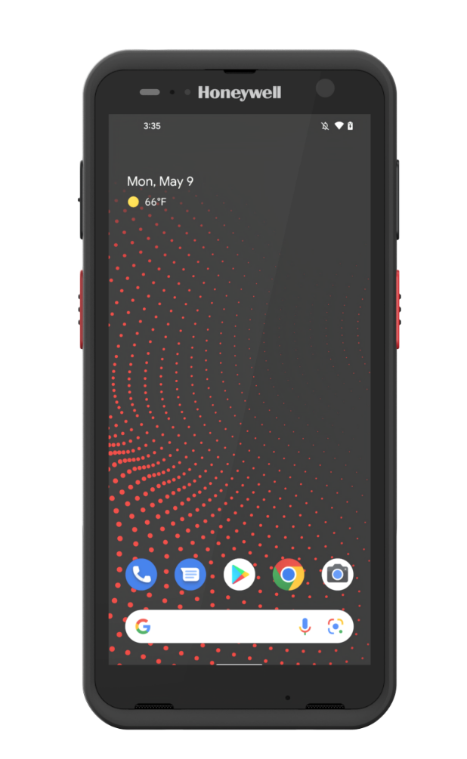
Honeywell ct70
Mobile computers
Candy xie
Global Offering Manager

Slide 2


Value to the customer
Transportation and Grocery Retail
CHALLENGES
Digital transformation speeding up
Skilled workforce shortage
Fragmented technologies
Threats from cyber attack in IoT networks

Slide 3

Value to the customer
Transportation and Grocery Retail
DIGITALIZATION
Big Data | Cloud Computing
AUTOMATION
IoT | Artificial Intelligence
5G, CBRS
Greater operational visibility
Less labor dependency
More secure operation
Wi-Fi 7, Wi-Fi 6E
RFID, NFC
Data analytics
Technology
Convergence
OCR
Barcode Technology
AI Agent /Machine learning
Cloud/Software
Facial Recognition/
Voice Recognition

Slide 4



CT70
INTRODUCING: THE CT70 MOBILE COMPUTER
Ultra-rugged, ultra-reliable, 5G connected device for enterprise customers that need a long service life and a predictable O/S upgrade path. Ready for the future with advanced features such as an AI processor and Wi-Fi 7.
Logistics
DSD
Retail
Field Service
Notes:
Need set up showing portfolio – why is it special?

Slide 5
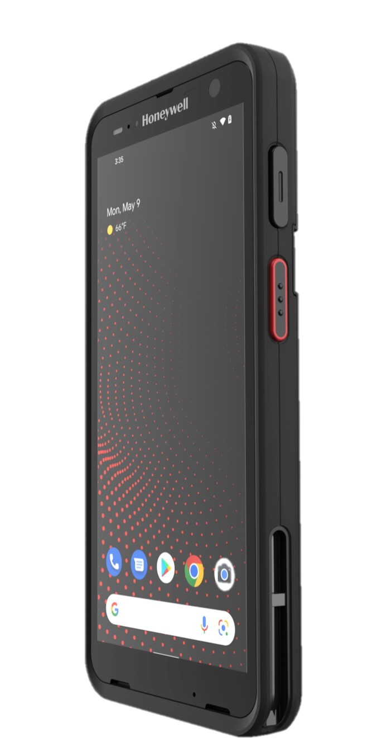







Designed for demanding users who need a Long-lifecycle & high-performance
FUTURE-PROOF
HIGH PERFORMANCE
EASY TO USE
Next-Gen Performance
and Edge AI capable
Committed Android
Support 15 to 19
Ultra- reliable:
5G, Wi-Fi 7/6E, BT v.6.0
New slim design without sacrificing ruggedness: 1.8m/6ft drop to concrete
Wireless charging, Qi compliant, 7692mah extended battery
True hot swap
Dual speakers delivers 100dB SPL, and 3 noise cancellation MICs
6’’ FHD display
with rain, glove
and stylus support
Quick-release
battery latch design saves time in battery replacement.
NFC tap to pair,
tap to pay from the screen (integrated NFC in display)

Slide 6
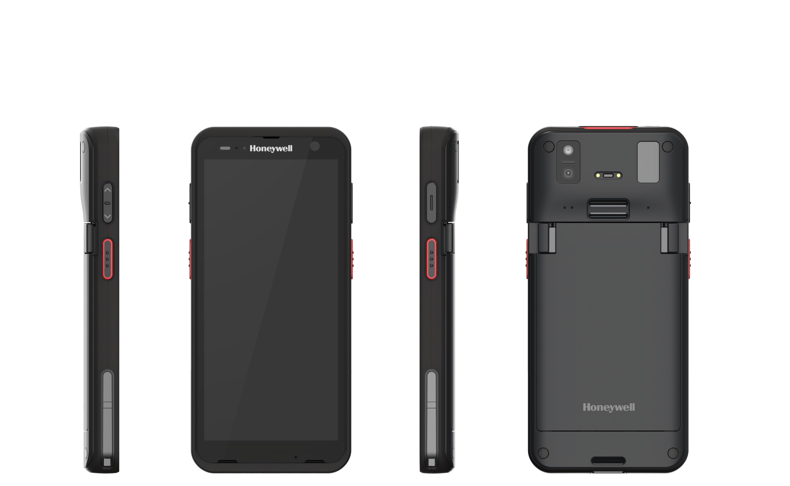
CT70 | industrial design
Bezel wraps around the front of the device providing drop protection to the cover glass.
CT70 is wrapped in a textured TPU material.
Pinch style double battery latch minimizes necessary effort in one-handed release.
Arched back for user comfort.
Charger attachment slots allow for booted and non-booted devices* using insert adapters
Dual speakers placed for maximum dB output
Size and placement of all buttons based on average dynamic hand dimensions for both male and female end users.
* Insert adapter of the universal cup needs to be removed to charge a CT70 with protective boot
6

Slide 7
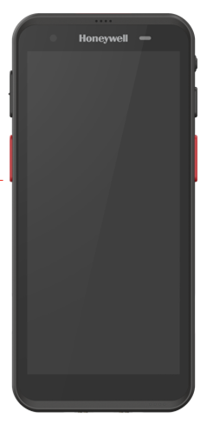
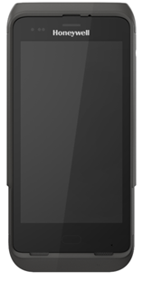
balanced ruggedness and ergonomics
7
CT45XP | v.s. | CT70
2.4 m (8ft) to concrete with boot 1.8 m (6ft) to concrete | Drop (-20°C to 50°C) | Same
3,000 0.5 m (1.6 ft) tumbles 1,500 1.0m (3.28 ft) tumbles | Tumble | Same
IP68 IP65 | IP Sealing | Same
78.6mm
79 mm
Ruggedness
5‘’
6‘’
163mm
170mm
Global Cellular,
Wi-Fi
Ergonomics
CT45XP | v.s. | CT70
4G-LTE | Cellular | 5G, CBRS 4G-LTE
Wi-Fi 6E, Wi-Fi 6 | Wi-Fi | Wi-Fi 7 Wi-Fi 6E, Wi-Fi 6
BT v5.1 | Bluetooth | BT v6.0
N/A | UHF | Yes
CT45XP | v.s. | CT70
53% | Screen-to-body ratio | 69%
19.2mm | Thickness | 16.7mm (grip area)
7

Slide 8
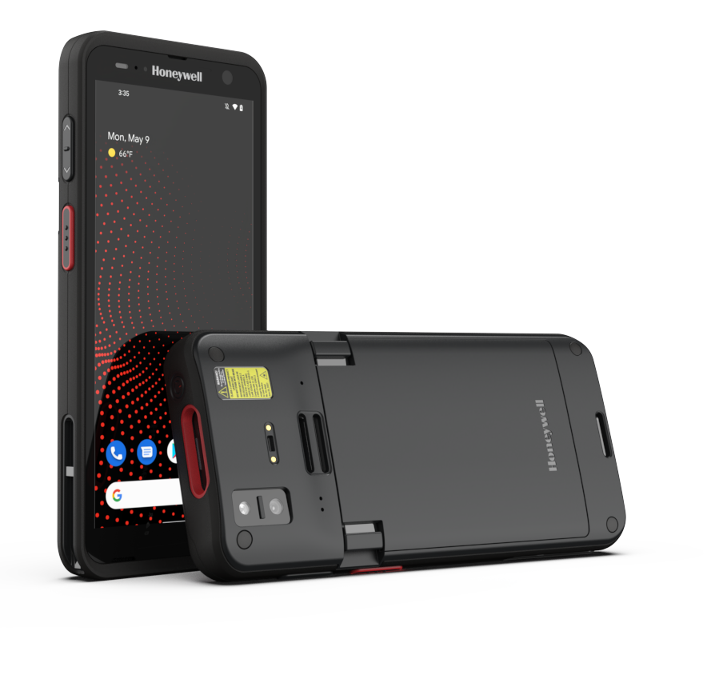

WI-FI 7’s benefit
Wi-Fi 7 Connectivity: Faster, Longer Range, Lower Latency, Higher Density
MULTI-LINK OPERATION
  Better user experience, lower latency, more reliable connection
  Wi-Fi 7 allows devices to connect to multiple frequency bands simultaneously, instead of just one (2.4GHz, 5GHz or 6GHz in the case of Wi-Fi 6E).
  Wi-Fi 7 allows automatic channel switch to reduce operational downtime.
    320 MHZ CHANNEL BANDWIDTH
      2x as much as data to be transmitted simultaneously as Wi-Fi 7(802.11be) doubles the maximum channel bandwidth from 160 MHz (offered by Wi-Fi 6) to 320 MHz.
HIGHER THROUGHPUT
    Wi-Fi 7 supports 4096 QAM that delivers up to 20% higher throughput than Wi-Fi 6 and Wi-Fi 6E (supports 1024 QAM), resulting in faster downloads and uploads.
    LOWER LATENCY
    Up to 60% reduction in latency over Wi-Fi 6 in multi-user environment.
BROADER NETWORK COVERAGE
    Wi-Fi 7’s Multi-AP Operation permits multiple access points to come together and form a single, continuous network. By having multiple access points in sync, the coverage can be broadened.
Information sourced from Wikipedia, Intel, Qualcomm, TP-Link, ASUS, Netgear, and others.

Slide 9
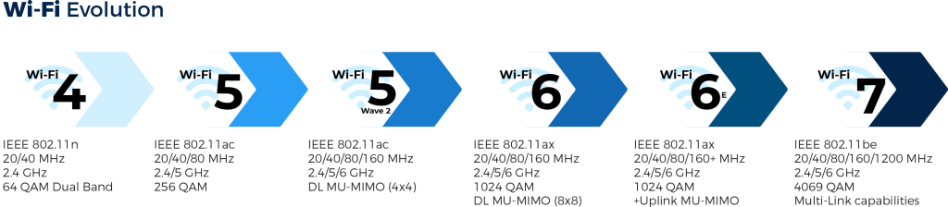
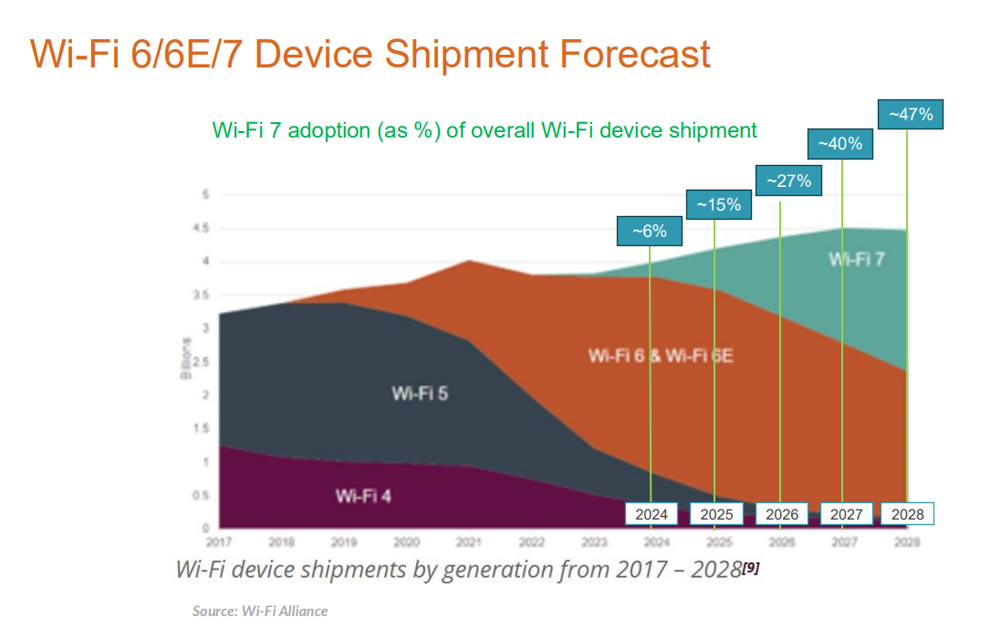
WI-FI 7 in industrial environments
BUSINESS CHALLENGES
Channel Congestion occurs when many devices connect to the same access point (AP) and share the same channel.
Weak Wi-Fi Signal can result from interference caused by materials such as metal, water, or brick walls.
Wi-Fi Security Breaches: Nearly two-thirds of organizations have experienced a Wi-Fi security breach.
WHY CT70 WITH WI-FI 7?
Reduced Channel Congestion: Utilizes simultaneous dual-band connections (5GHz + 6GHz) to support 320MHz bandwidth channels, maximizing throughput and delivering ultra-high speeds, low latency, and improved reliability, even in the dense environment.
Seamless Access Point Switching: Enables automatic connection to multiple access points without manual intervention, enhancing operational efficiency and reducing downtime.
Enhanced Security: CT70 supports the WPA3 protocol—the most advanced Wi-Fi security standard—offering stronger authentication, encryption, and intrusion detection to keep your network secure.
CT70 with Wi-Fi 7 is the Game Changer for Industrial Connectivity

Slide 10
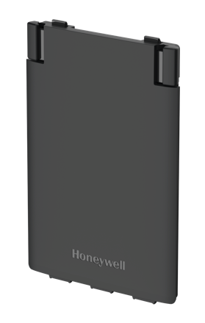
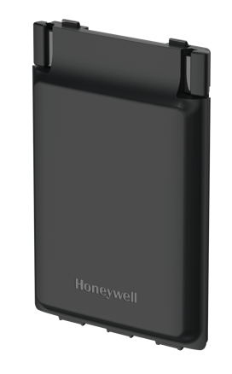
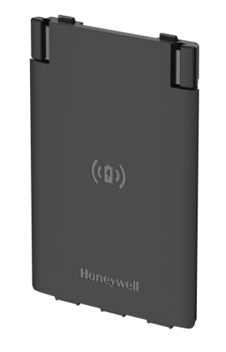
3 battery options
Improved User Experience, Reduced Operating Downtime
4775mAh, Standard
4775mAh, Wireless
7692mAh,
Extended
Quick-release battery
latch design supports one hand operation, saves time
in battery replacement.
Supports full shift
operation and lasts longer than competition at the same test environment.
Highly reliable: no terminal charging pin wear and tear over long period of use.
Qi compatible: Allows CT70 with wireless battery to be charged on many off-the-shelf Qi compliant chargers.
Reduce operational downtime: supporting up
to 3 shifts on a single charge
Highly compatible: Fully compatible with existing CT70 QBC/home bases, CT70 scan handle, CT70 protective boot, and CT70 wearable kit

Slide 11

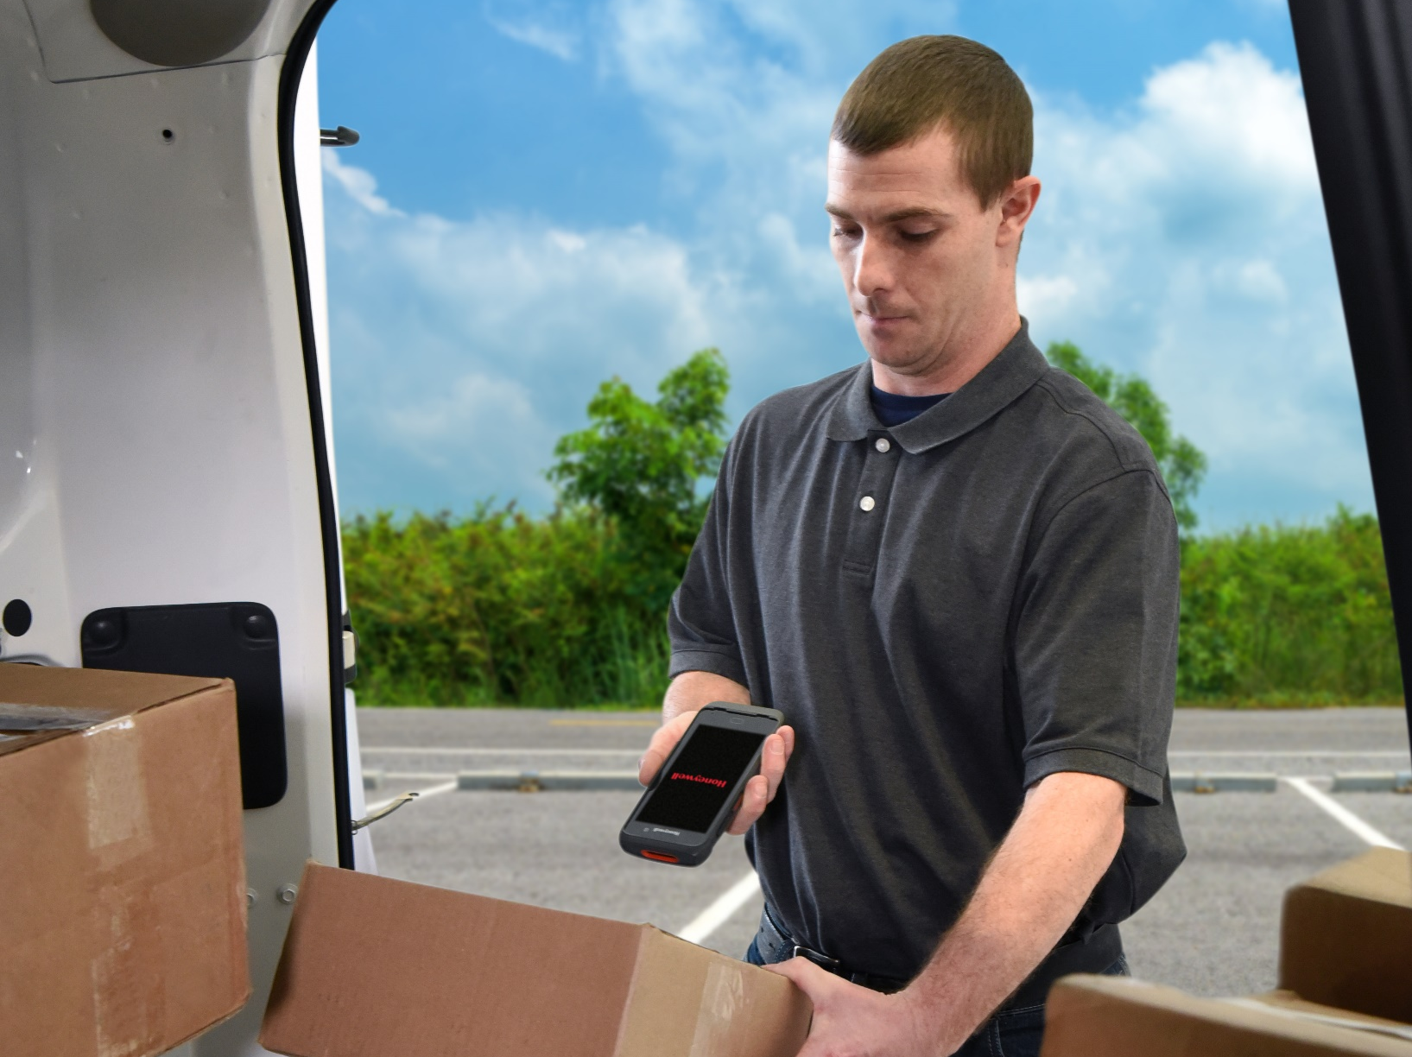
Honeywell CT70 RFID
All in one device incl. Integrated RFID
Ultra-reliable connectivity for frontline workers from truck loading to item-level stock management
UHF RAIN RFID
    Compliant with EPC Class 1 Gen2, ISO 18000-6C, and ISO 18000-63 standards
    RFID frequency range: 865–868 MHz and 902–928 MHz
    Supports 5G-NR: FR1, CBRS, Private 5G and Wi-Fi 7/6E
    Compact, lightweight, and pocketable design with a flat back
    Enables precise location tracking of specific packages, pallets, or boxes within arm’s reach
    NFC tap on screen
    Bluetooth version 6.0 as the 2nd BLE enables high precision device finder capability.
    Available as a global SKU
    All-day battery life with fast-charging 4,775 mAh hot-swappable battery and intelligent battery management; 7,692 mAh extended battery option available
Integrated RFID in T&L and Retail
Projected launch: 1H26; Variable by Country

Slide 12
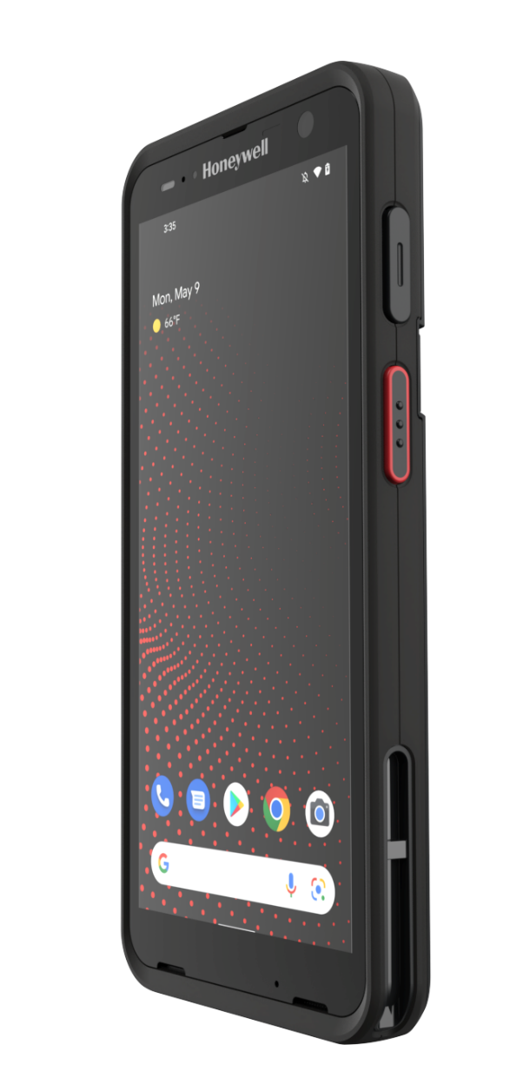
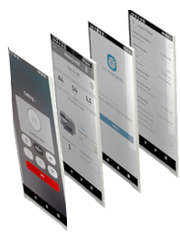



a complete solution set
A One-Stop Solution That’s Easy to deploy and Use
Operational
Intelligence
CT70 + SMART PAY
Secure and seamless payment with tap on glass payment
Guided Work Solutions
MDM
Smart Talk
CT70 + SMART TALK
Unified communication with PTT, texting, Voice over IP, voicemail, and video calls
CT70 + GUIDED WORK SOLUTION
Order picking, packing and fleet M&I
SmartOCR
SwiftDecoder
CT70 + OPINTEL
Real-time IT asset tracking and data analytics with Op Intel
Android 15-19
Commitment
CT70
5+5 Lifecycle

Slide 13
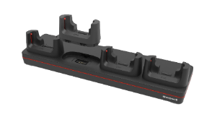
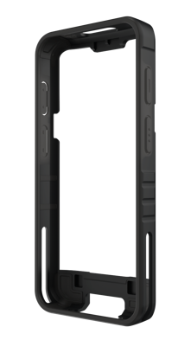
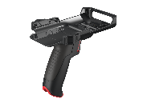
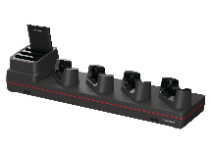
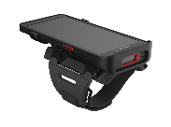

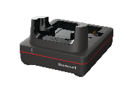

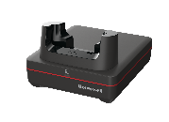
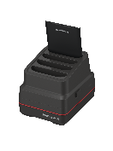

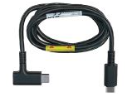
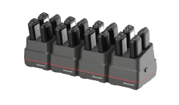
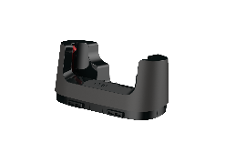

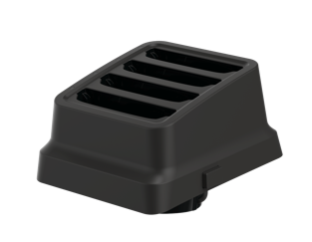
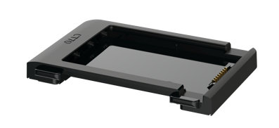

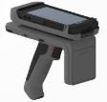


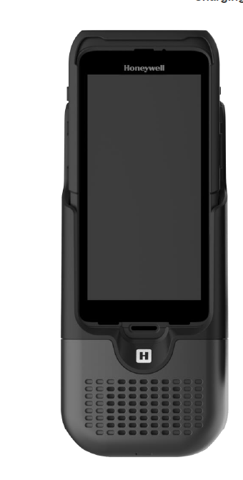
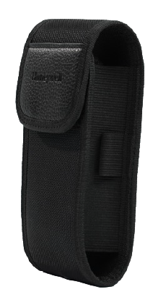
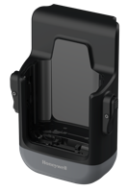

Comprehensive Accessory Portfolio
ACCESSORY |  | CHARGERS
Universal Docks (reused base) | 4-bay
 | 4- bay Net Base
 | 5-bay
 | 5-bay Net base
 | 1 bay
 | Ethernet Base
 | Display Dock
 | QBC-4 bay or 16 bay
Universal cup (CT70, spare battery, QBC)
Metal rack (reused)
Wireless Vehicle dock
Wired Vehicle dock
Cigarette lighter adapter (reused)
ACCESSORY | MISC.
Protective Boot
USB-C Headset (reused)
Screen Protector Corning™ Gorilla™ Glass 7i
USB-C Cable (reused)
Hand strap (Reused)
Stylus (reused)
Holster
ACCESSORY | ENABLING SOLUTIONS
Booted and non-booted Scan Handle
Wearable Kit (reused wrist band)
Extended battery
Wireless battery
Standard battery
IH45 Sled (reused IH45 RFID grip)
* Gorilla is a trademark of Corning

Slide 14



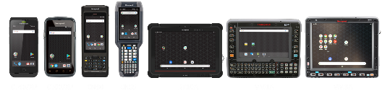




Mobility Edge™
A Durable, Stable, Secure Foundation
Android-Based, Uniform Software/Hardware Platform
Deployment and Performance Optimizing Tools
Best Available Security and Lifecycle Duration
>15 Mobility Edge model lines deployed
Durable, stable, secure platform
Continuous Android compatibility
Longest SW and HW support
1st
Secure product, policy and practice
Forward compatible architectures
Management & deployment SW ecosystem
Faster time-to-value
50% reduction in lifetime TCO
Up to 66% deployment cost reduction
Android is a trademark of Google LLC

Slide 15
CT70 On the Mobility Edge Platform
Future Compatible
2025 | 2026 | 2027 | 2028 | 2029 | 2030 | 2031 | 2032 | 2033 | 2034 | 2035
Android 15 HON support using Google Security Patches |  |  | Honeywell Android Service
 | Android 16
 |  | Android 17
 |  |  | Android 18
 |  |  |  | Android 19 |  |  | Honeywell Android Service
Availability for purchase to 2031+ |  |  |  |  |  | Honeywell Hardware Service to 2036+
Dates are estimates subject to change. HW availability and service is subject to the availability of parts from suppliers
HW Service and Android Support is offered as part of a Service Contract
Android is a trademark of Google LLC
Not all SKUs have sufficient memory capacity to run all versions of Android. Verify configuration compatibility with chosen software
Notes:
HW availability pertains to model lines. Some SKUs may be discontinued based on market demand
HW availability and service is subject to the availability of parts from suppliers
HW Service and Android Support is offered as part of a Service Contract
Android is a trademark of Google LLC

Slide 16




migration
Maintain 4 pillars of Mobility Edge
  Unmatched lifecycle and security, certainty and duration
    Commit Android versions as long as possible, in collaboration with Qualcomm and Google.
  Accelerate Deployments
    Provisioning and device management tools compatible across the platforms
    Universal dock platform with a CT70 universal cup
  Optimize Performance
    Tools, applications, SDKs, APIs, MDM - compatible across the platforms
New with the CT70 (CT60/CT45XP → CT70)
  Comparable ruggedness without CT45/CT60’s thickness
  A bigger, brighter, sunlight readable 6-inch display.
  Android versions 15 – 19 committed.
  Latest cellular, Wi-Fi, Bluetooth connectivity
  Integrated RFID; Integrated NFC in display; Edge AI ready
  Extended range of accessory types (wireless battery,
  extended battery, 16 bay charger)
  FSC Recycled packaging
Accelerate Deployments
Optimize Business
Performance
Extend Lifecycle
Strengthen Security
The average deployment
cost of IT staff is over $700 per device
Extending device refresh
from 5 to 8 years lowers total cost of ownership by over 50%
In 2019, the average
cost of a data breach was
$3.9 million
An average of one mobile availability problem per shift can reduce productivity per mobile worker by
$20,000 per year
16

Slide 17
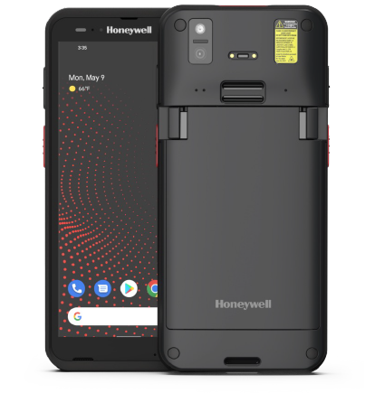
Product Differentiators
For customer with Z TC5X install base
  SELLING
  POINTS
  COMPETITIVE
  DISTINCTIONS
Mobility Edge™ platform supporting Android 15 - 19
Survives repeated 6-ft drops to concrete, 8-ft w boot
5G, CBRS & Wi-Fi 7/6E/6
Corning® Gorilla® Glass 7, 6’’ FHD display, 600+ nits
Full-shift wireless or standard battery; multi-shift extended battery; True hot swap
Universal dock platform
Mobility Edge™ platform for unbroken Android support
Next-gen system performance
Well balanced ruggedness and enterprise ergonomics
Ultra-reliable connectivity
Unprecedented user experience
Comprehensive accessory ecosystem

Slide 18
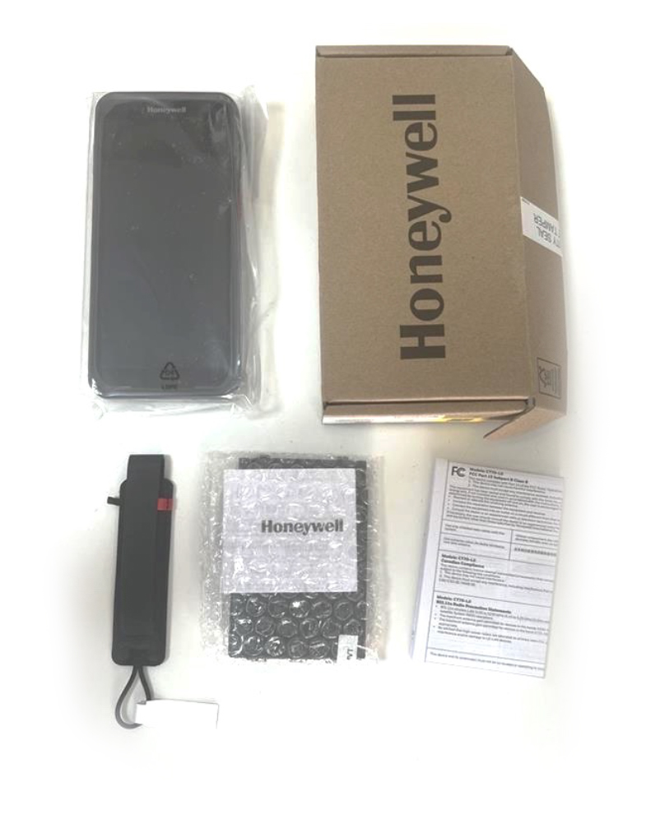
Configurations
SKU NUMBER | WWAN/ WLAN | RFID/NFC | MEMORY | ENGINE | BATTERY | ANDROID | REGION
CT70-L0N-058CS104G | WLAN | NFC | 8/128G | S0803FR | Standard | GMS | Global
CT70-L0N-057CS104G | WLAN | NFC | 8/128G | S0703 | Standard | GMS | Global
CT70-X1N-058CS104G | WWAN | NFC | 8/128G | S0803FR | Standard | GMS | Global
CT70-X1N-057CS104G | WWAN | NFC | 8/128G | S0703 | Standard | GMS | Global
CT70-X1N-058CW104G | WWAN | NFC | 8/128G | S0803FR | Wireless | GMS | Global
CT70-X1N-057CW104G | WWAN | NFC | 8/128G | S0703 | Wireless | GMS | Global
CT70-L0N-058CW104G | WLAN | NFC | 8/128G | S0803FR | Wireless | GMS | Global
CT70-L0N-057CW104G | WLAN | NFC | 8/128G | S0703 | Wireless | GMS | Global
CT70-X1N-058CE104G | WWAN | NFC | 8/128G | S0803FR | Extended | GMS | Global
CT70-X1N-057CE104G | WWAN | NFC | 8/128G | S0703 | Extended | GMS | Global
CT70-L0N-058CE104G | WLAN | NFC | 8/128G | S0803FR | Extended | GMS | Global
CT70-L0N-057CE104G | WLAN | NFC | 8/128G | S0703 | Extended | GMS | Global
CT70-L0N-058CS204G | WLAN | NFC | 8/128G | S0803FR | Standard | non-GMS | Global
CT70-L0N-057CS204G | WLAN | NFC | 8/128G | S0703 | Standard | non-GMS | Global
CT70-X1N-058CS204G | WWAN | NFC | 8/128G | S0803FR | Standard | non-GMS | Global
CT70-X1N-057CS204G | WWAN | NFC | 8/128G | S0703 | Standard | non-GMS | Global
CT70-X1R-058CS104G | WWAN | RFID/NFC | 8/128G | S0803FR | Standard | GMS | Global
CT70-X1R-057CS104G | WWAN | RFID/NFC | 8/128G | S0703 | Standard | GMS | Global
CT70-X1R-058CE104G | WWAN | RFID/NFC | 8/128G | S0803FR | Extended | GMS | Global
CT70-X1R-057CE104G | WWAN | RFID/NFC | 8/128G | S0703 | Extended | GMS | Global
CT70-X1N-058CS201C | WWAN | NFC | 8/128G | S0803FR | Standard | non-GMS | GC only
CT70-X1N-057CS201C | WWAN | NFC | 8/128G | S0703 | Standard | non-GMS | GC only
CT70 UNBOXING

Slide 19







AN INTEGRATED SOLUTION PROTECTS
THE INVESTMENT OF OWNERSHIP
MOBILITY EDGE™
Logistic
Retail
FUTURE-PROOF
HIGHLY RELIABLE
EASY TO USE
Blazing speed with advanced Octo core 2.9GHz chipset with built in NPU
Ultra- reliable connectivity:
5G, Wi-Fi 7/6E, BT v.6.0
Android support from 15 to 19 (5+5)
Superior rugged device in a slim housing to achieve 1.8m/6ft drop to concrete across operating temp
Wireless charging, Qi compliant, 7692mah extended battery;
100db dual speakers
Sweet spot of sleek
design and high
ruggedness.
Intuitive quick battery release style. True
hot swap
Integrated NFC in
screen Integrated RFID;
Comprehensive
accessory ecosystem
Strengthen
Security
Extend
Lifecylce
Till 2036
Optimize
Performance
Accelerate
Deployments
19
Notes:
Add How?

