Slide 1
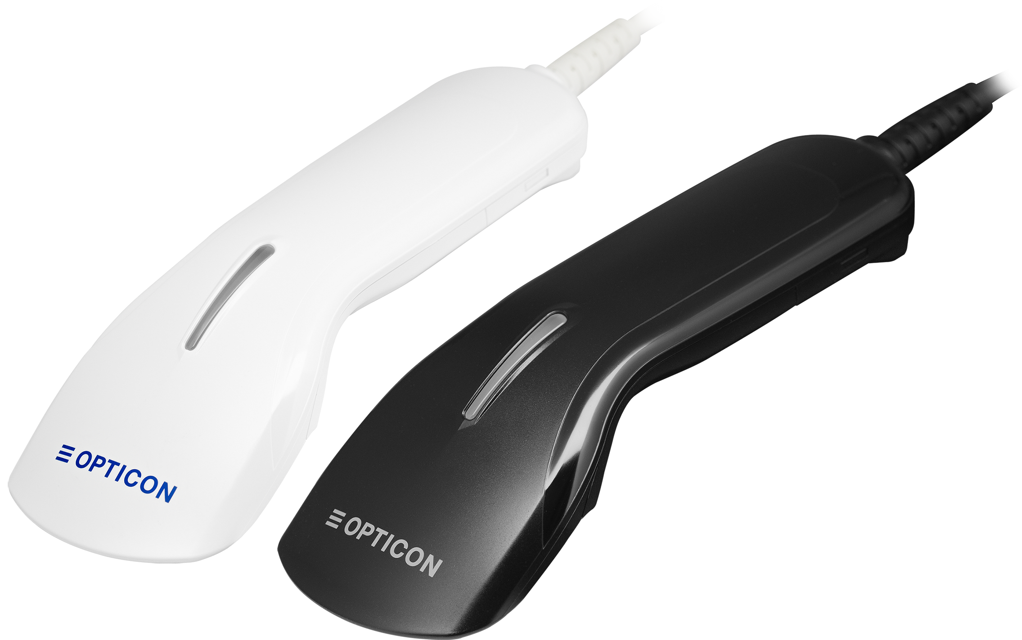
Introducing the L-22XS -
Next-level 2D handheld scanner

Slide 2
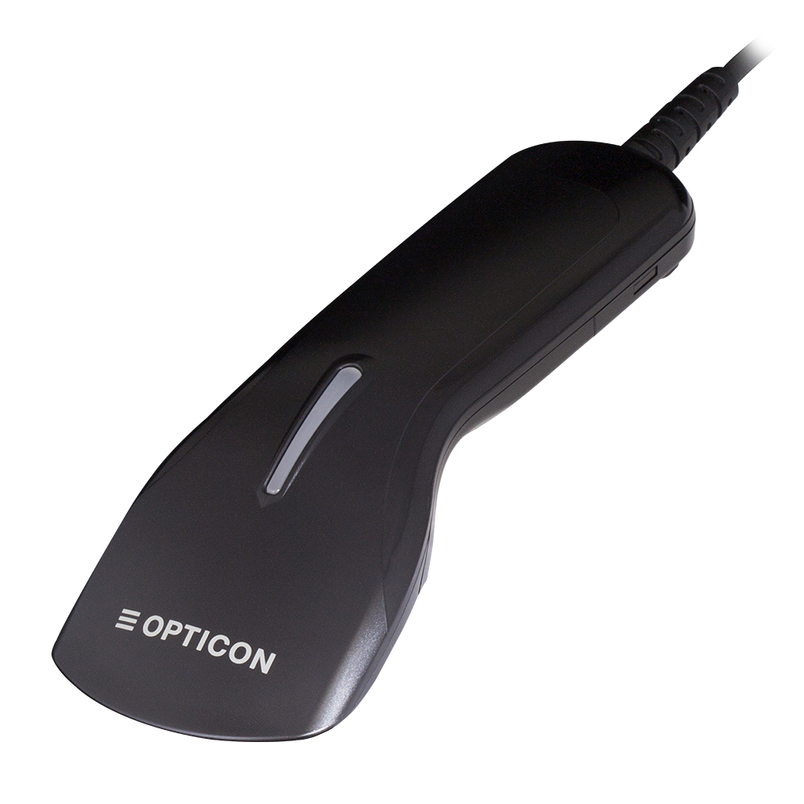
L-22X upward compatible
The L-22XS features improved performance and upward compatibility, allowing it to be used without any additional configuration.
Hardware/software compatibility
Comprehensive quality improvements
Redesigned for best-in-class performance
Equipped with long-life components
L-22XS
From 2026
L-22X
From 2017

Slide 3
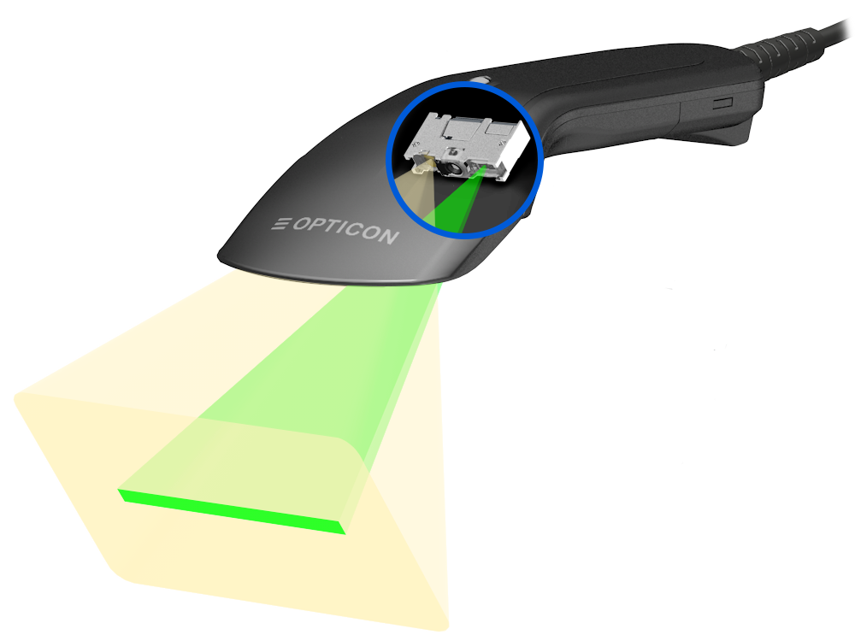
The all-new imager engine
120% Aiming brightness
A new LED combined with an optimized lens design improves luminous efficiency while maintaining the sharp aiming outline of the current model.
120fps High-speed CMOS sensor
The frame rate of the global shutter CMOS sensor has been increased from 100 fps to 120 fps for faster image capture.
Improved imaging lens design (same optical specification)
180 to 500% more efficient LED illumination
Optimized lens design improves far-field scanning range and enhances near-field 2D minimum resolution.
A new lens design combined with NICHIA’s high-grade LED improves luminous efficiency by 180% to 500%, depending on the reading distance.

Slide 4
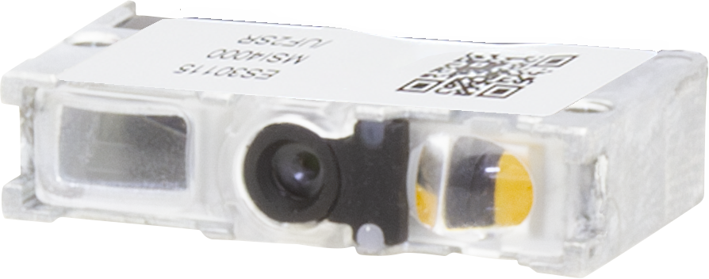
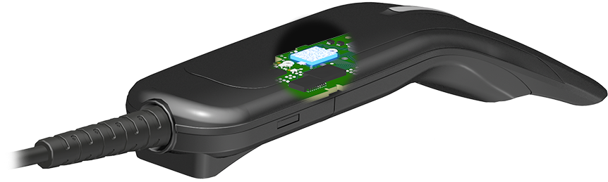
The all-new imager engine
New customized chipset (CPU+GPU+AI core)
Improved processing speed with CPU (x1.6 faster) and GPU.
New ESD immunity design
Antimicrobial now available in black model
The new board design has significantly improved ESD immunity.
In addition to the white model, the black model now also features an antimicrobial case for improved hygiene.

Slide 5
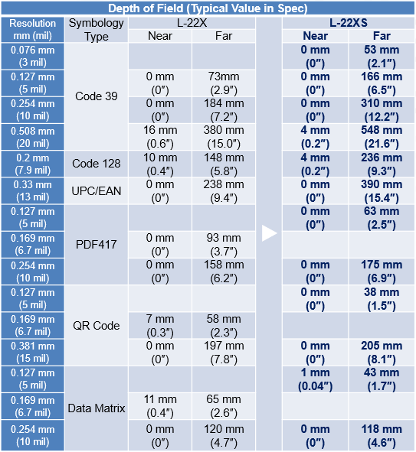
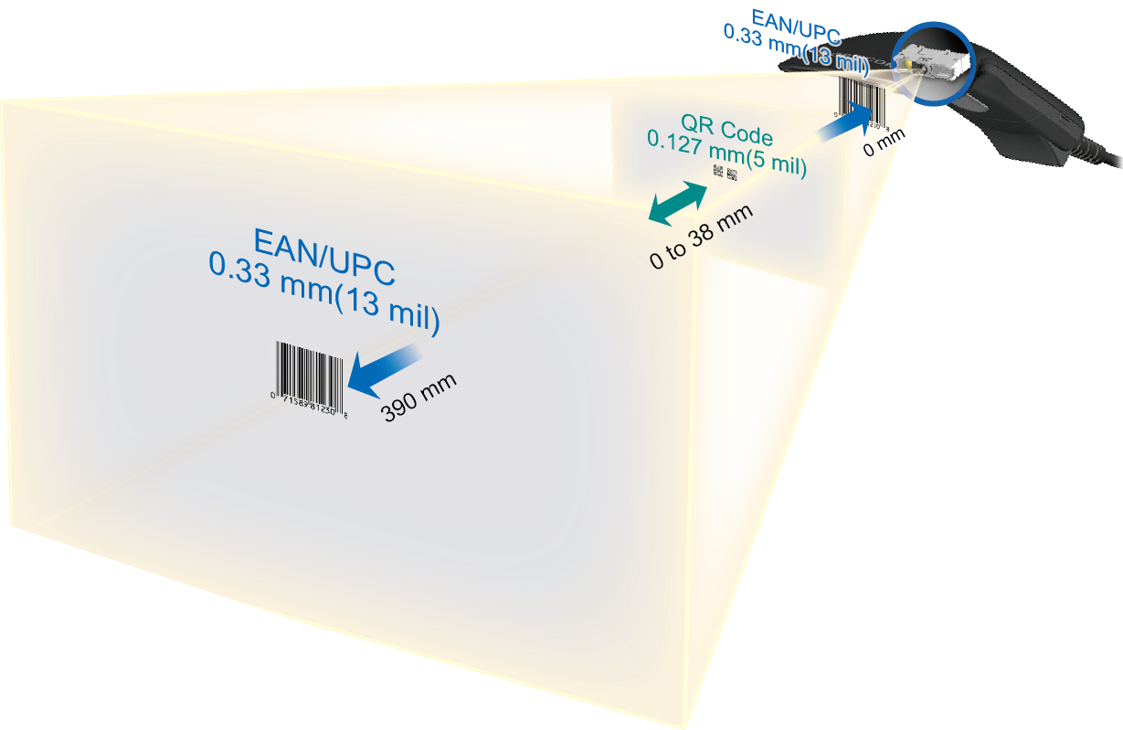
Best-in-class DoF and resolution
Depth of field has been improved:
Improved imaging lens to read high resolution code
Improved LED illumination efficiency reduces noise, even at far distances
Improved decode algorithm
* Guaranteed value is different

Slide 6
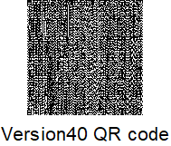
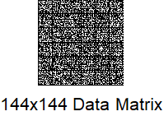
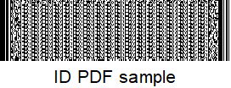
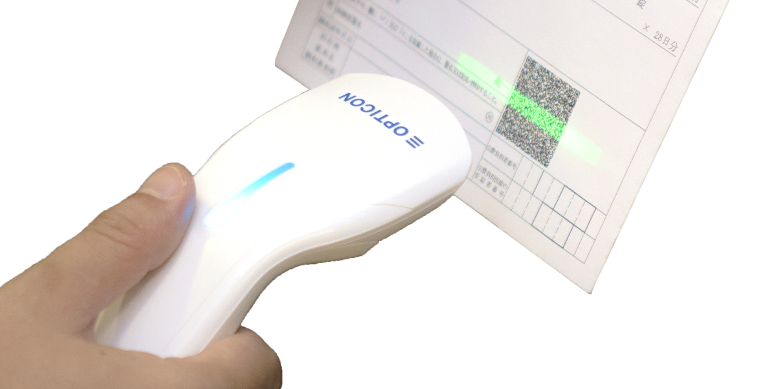
Best-in-class scanning speed
The L-22XS achieves the fastest scanning speed in its class.
Competitor
60fps:16.7ms
CPU
L-22X
100fps:10.0ms
CPU
faster
L-22XS
120fps:8.3ms
x1.6CPU+GPU
Processing speed
Average 40% faster (than L-22X)
Global shutter CMOS sensor frame rate:100fps to 120fps
CPU clock during scan: x1.6
Improved code search algorithm

Slide 7
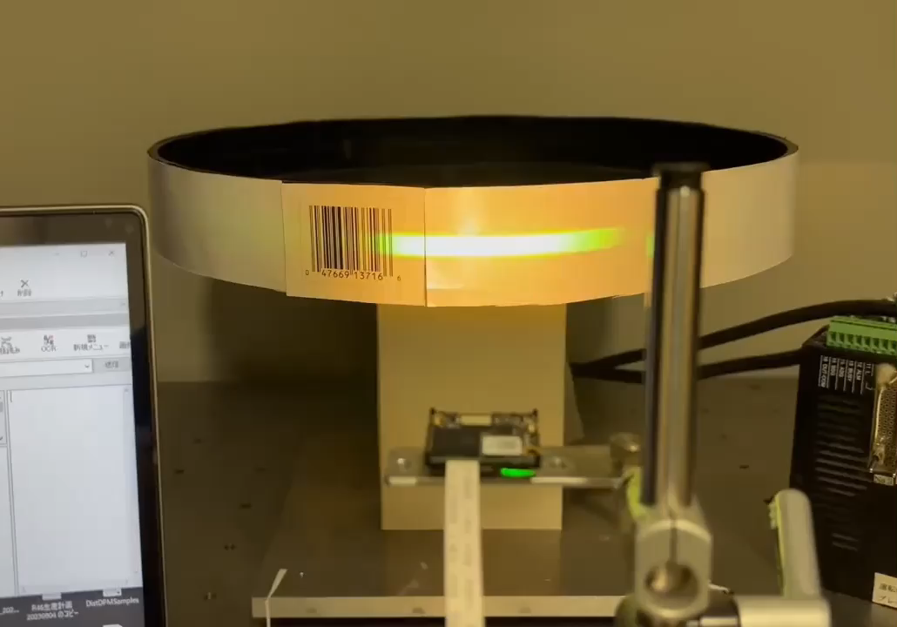
Fast motion tolerance
Exceptional motion tolerance and versatile media reading in auto-trigger mode:
Motion tolerance of 10 m/s (previous model 2.54 m/s)
Due to improve LED illumination efficiency, the imager engine now achieves a typical LED peak pulse width of 60μs, at a distance of 130mm, under default exposure control settings.
Video configuration:
UPC only ( J1 )
Continuous reading ( S2 )
Note: Exposure control is an initial setting.

Slide 8
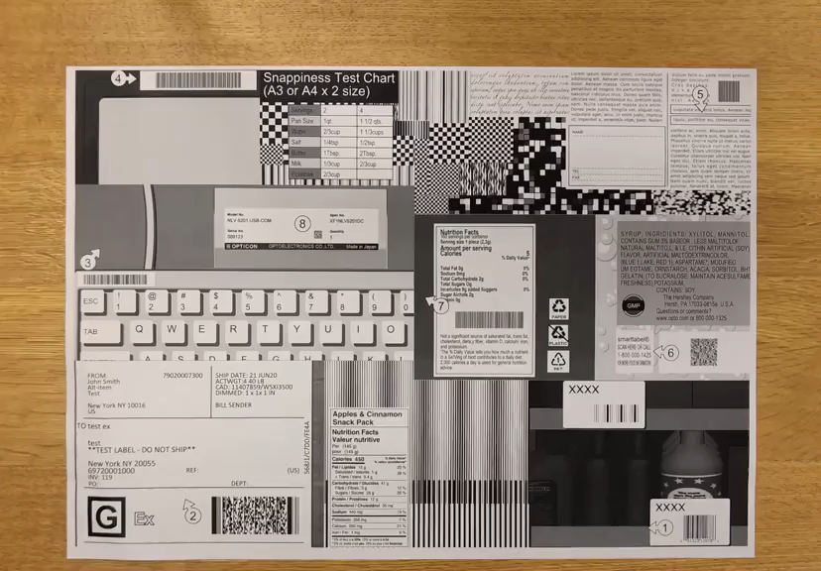
Experience ultra-fast scanning performance
Snappy scanning performance has been improved:
Motion tolerance improved from 2.5 m/s to 10 m/s
CPU clock speed increased by 1.6x during scanning
Upgraded code search algorithm for faster results
Improved exposure control for better accuracy

Slide 9
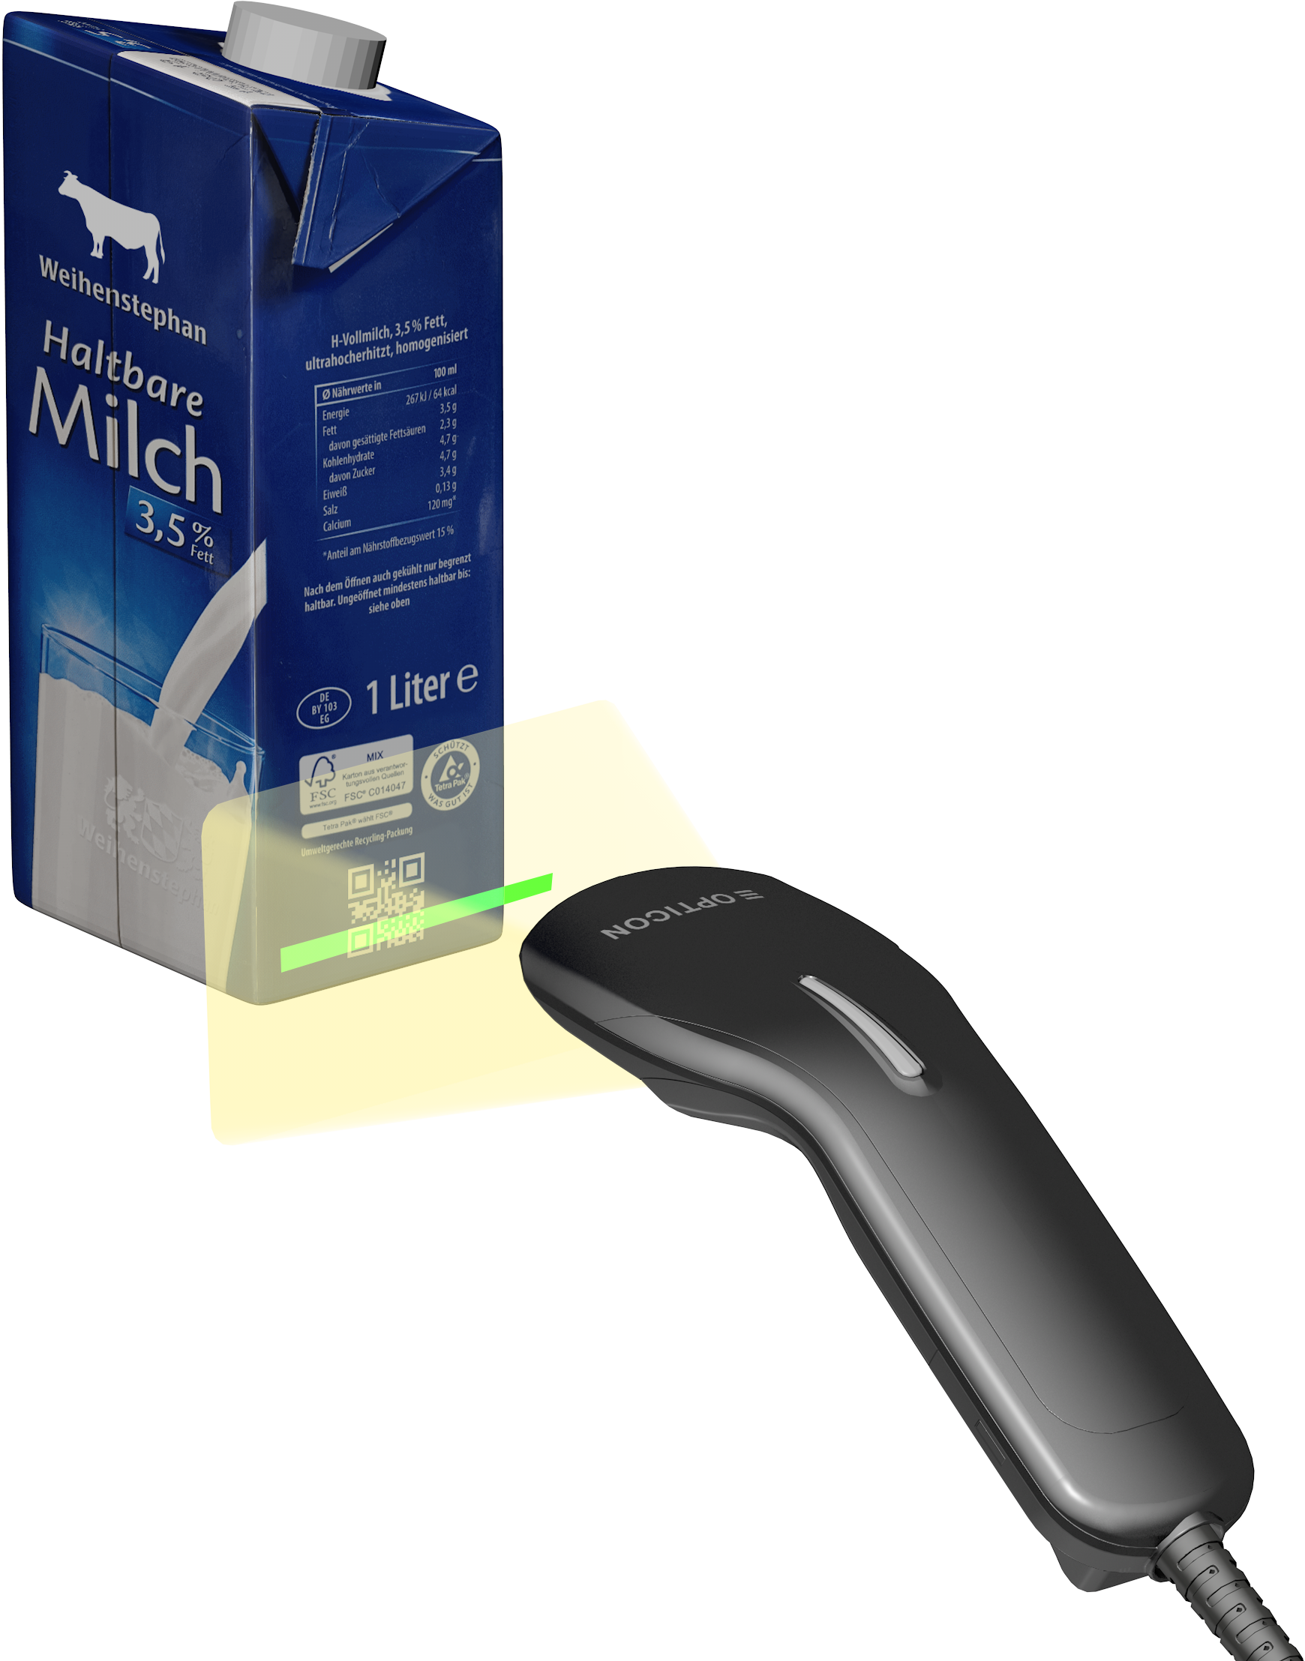



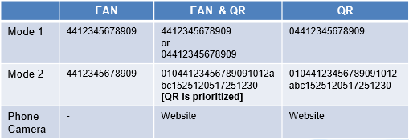


GS1 Digital Link
Supports GS1 Digital Link reading mode 1 and mode 2
Default
Default Mode 1
Default Mode 2
GS1 Digital Link QR
Website: various information and services related to the item.
GS1 data management: GTIN, Lot, expiry date, origin, etc.
GS1 AI
Output the Digital Link URI string as is
Extract and output only the GTIN from the Digital Link URI
Output the GS1 data portion, when EAN and QR are scanned, the QR will be read first.
AI | Description
AI (01) | GTIN (Global Trade Item Number)
AI (10) | Batch/Lot Number
AI (15) | Best Before Date (YYMMDD)
AI (17) | Expiry Date (YYMMDD)
GS1 Digital Link test sample

Slide 10
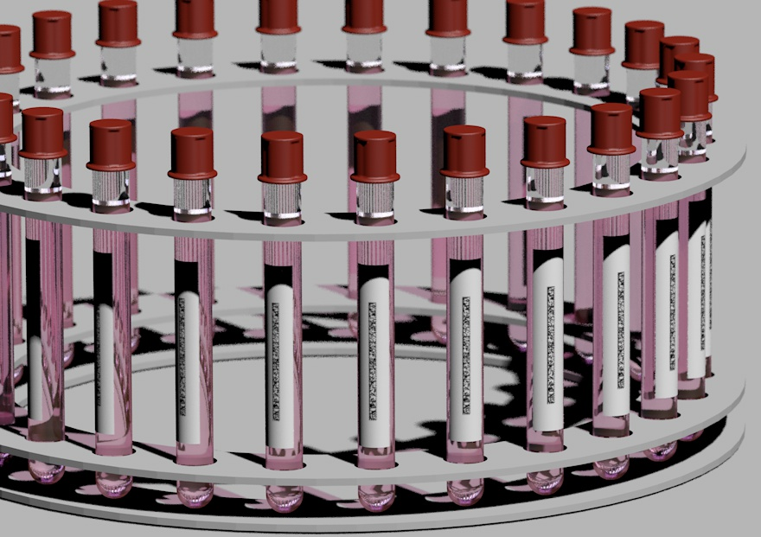
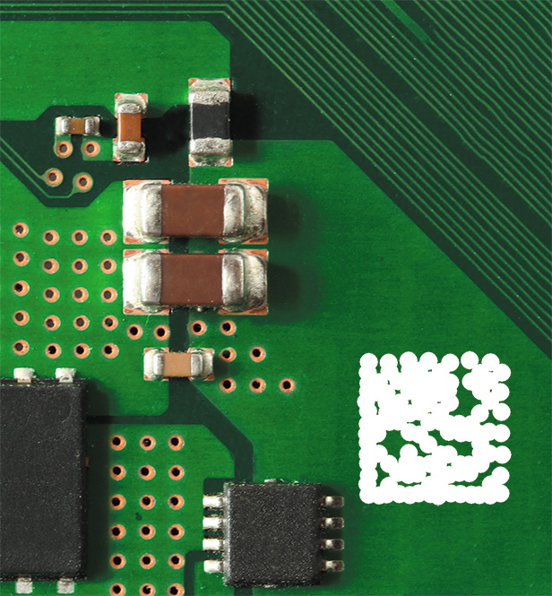
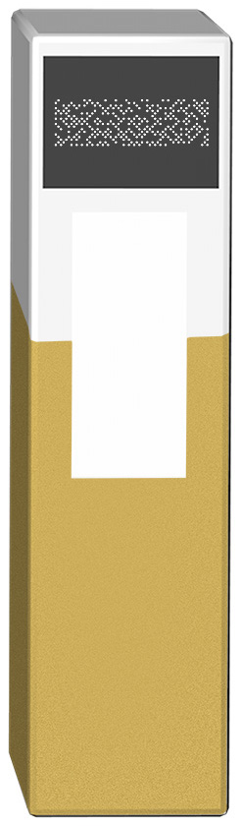

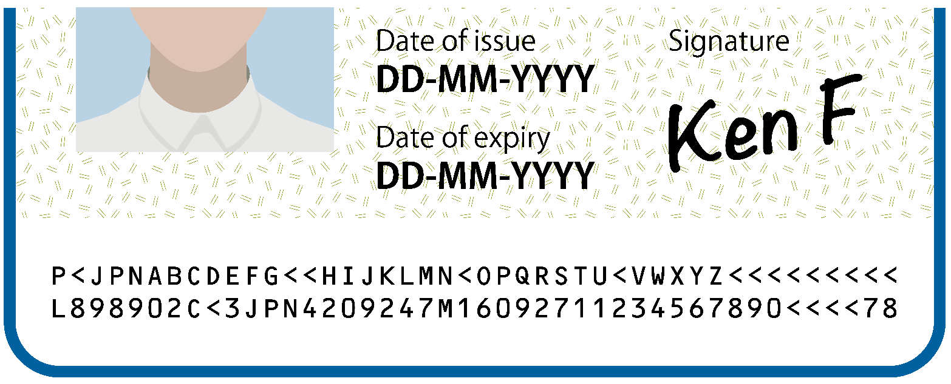
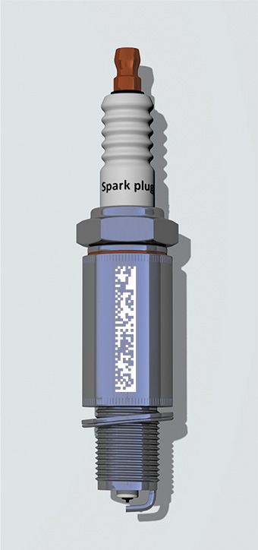
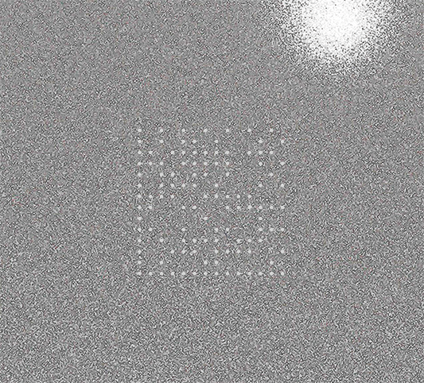

Always scanning for new IDs
Dot code
OCR
New rMQR
DMRE
DPM
Ticket to ride
to Tokyo
Ticket to ride
PRICE
Discount
$8.0
$ 6.5

Slide 11
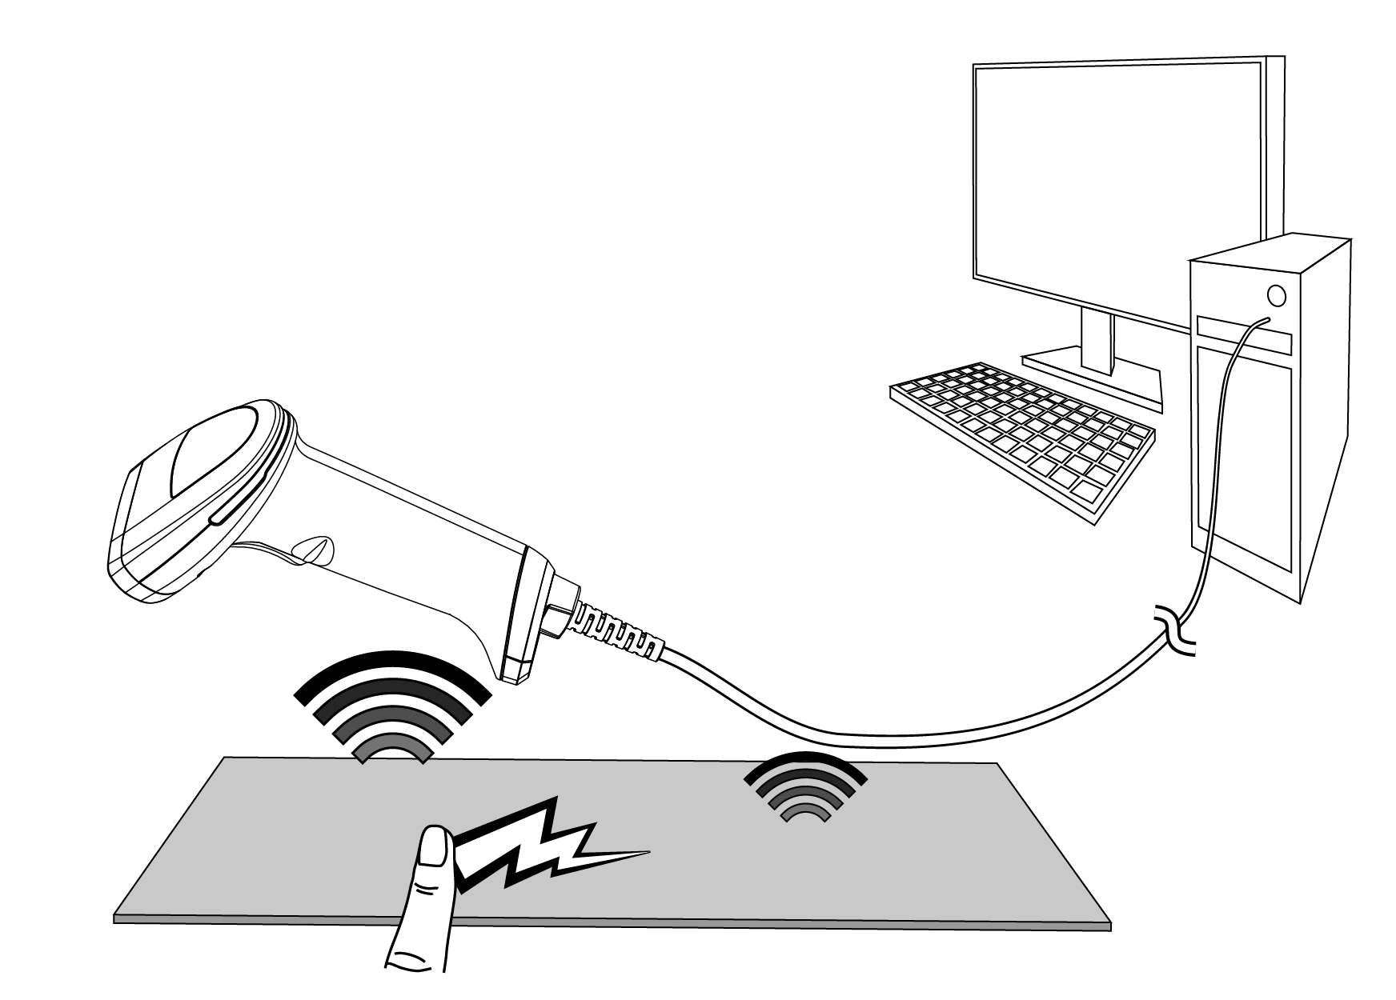
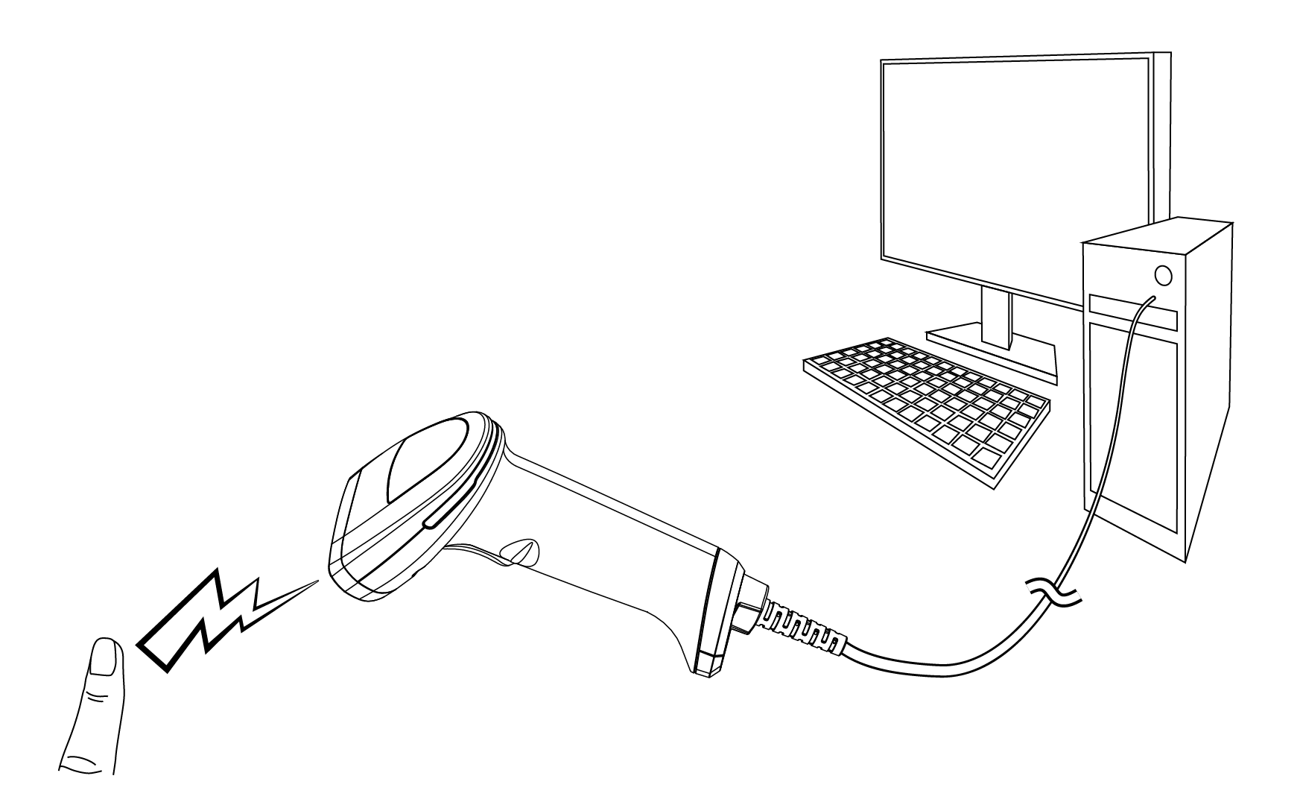
Best-in-class of ESD immunity
Indirect discharge
Standard: IEC 61000-4-2
Standard value: ±6KV
(Class 2)
Direct discharge (air)
Standard: IEC 61000-4-2
Standard value: ±8KV

Slide 12
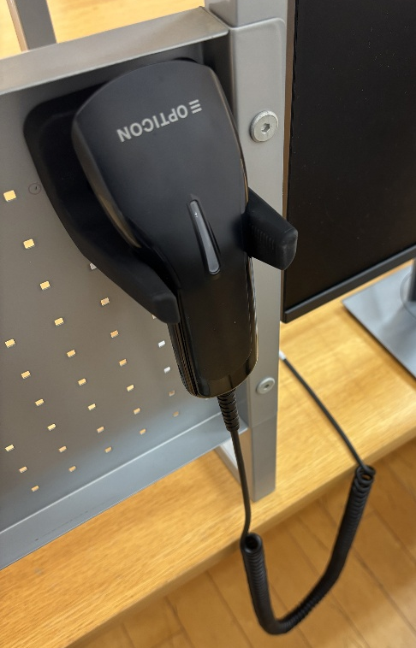
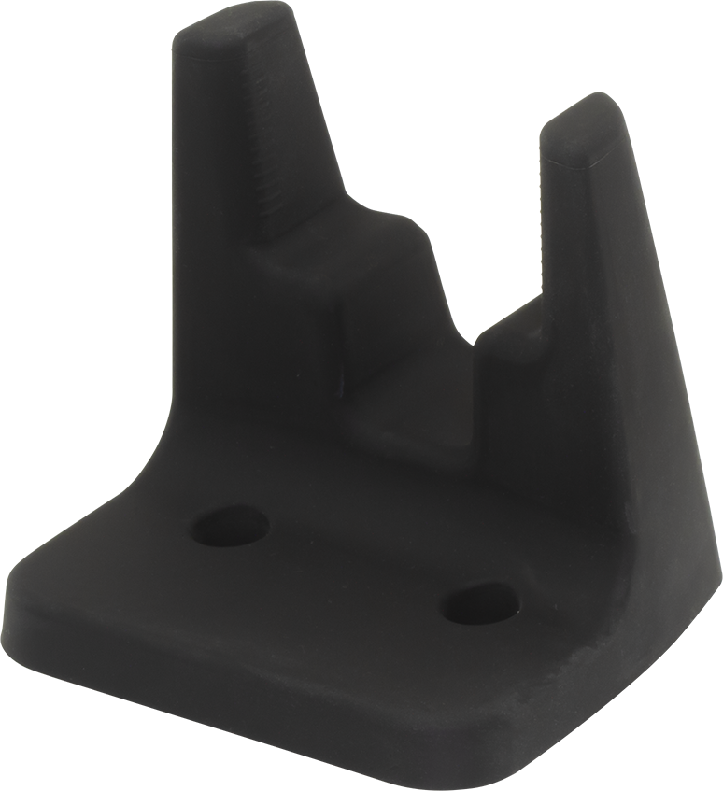
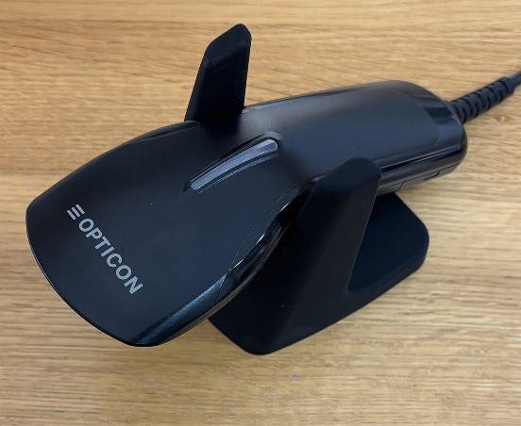
Enhance with optional accessories
L-22XS comes several optional cables and a wall mount stand.
New ST-2 wall mount
Straight cables
Black cable – USB – 2.1m
Black cable – USB – 4.0m
White cable – RS232C – 4.0m
* MOQ applies
* ST-2 is compatible with other scanners

Slide 13
Thank you for your attention

